Slide 1


Instructor Development Program
    Padrões Gerais de Mergulho RAID

Slide 2

VISÃO GERAL
Normas e Procedimentos Gerais.
O documento RGDS é a base de todo treinamento RAID.
Durante esta sessão, você revisará o RGDS de capa a capa com seu Instrutor, pois seus candidatos a Instrutor precisarão de um conhecimento profundo deste importante documento.

Slide 3
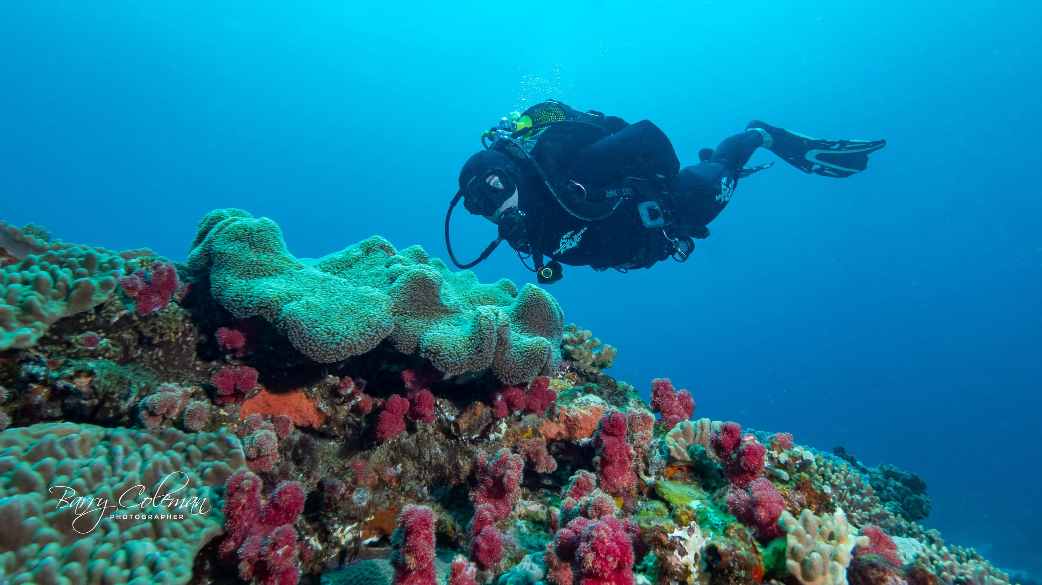
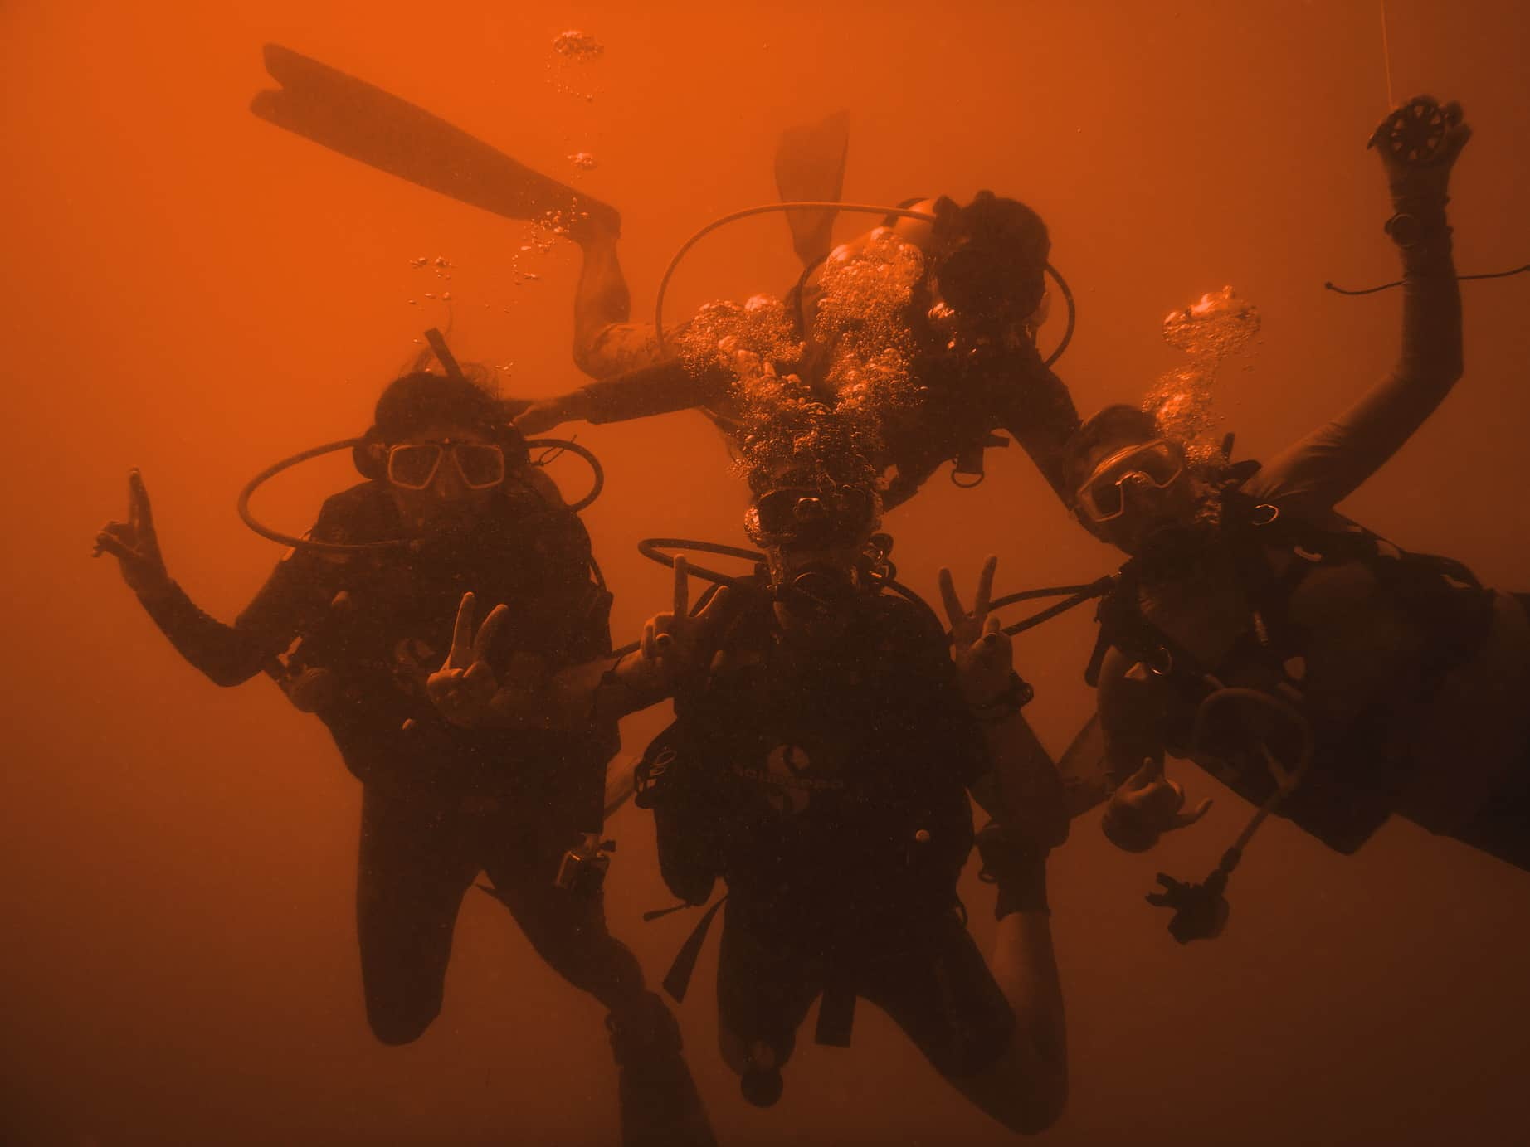

Padrões Gerais de Mergulho RAID
Seções do Curso
Padrões Gerais de Mergulho RAID.
Em geral.
Definições para os termos usados ​​neste documento.
Padrões do Curso.
Padrões de percurso de Circuito Aberto Recreativo.

Slide 4
Padrões Gerais de Mergulho RAID
Seções do Curso
Programas RAIDADAPTIVE.
Cursos e classificações de Liderança (Circuito Aberto).
Circuito Aberto Técnico.
CCR.

Slide 5
  Definição de um Profissional RAID.
  A diferença da RAID.
SEÇÃO 1 PADRÕES GERAIS DE MERGULHO RAID
  Status de Membro e manutenção
  Julgamento do Instrutor.
  Padrões éticos e códigos de conduta.
  Padrões de Mídia Social.
  Comportamento ambiental.
  Processo de resolução de reclamações da RAID.
Notes:
1. RAID GENERAL DIVING STANDARDS
Definition of a RAID Professional
We have added definitions of what a professional, a dive centre and a student are so that we do not have to write the word RAID every time we mention of one of these entities. After all, this is the RAID General Diving Standards, so it only discusses RAID.
We have added new sections on the following subjects:
THE RAID DIFFERENCE
Identifies what makes RAID different to other agencies.
MEMBERSHIP STATUS AND MAINTAINANCE
Here we have added more detailed information and clearly defined the different status’s that a professional may hold.
INSTRUCTOR JUDGEMENT
Defines exactly what judgement is and how it affects you as a dive professional
ETHICAL STANDARDS AND CODES OF CONDUCT
We have added entirely new sections on Code of Conduct for Scuba Instructors and a Youth Code of Practice.
SOCIAL MEDIA STANDARDS
Since social media plays such a huge role in our lives as professionals, we have defined ethical codes of conduct when using social media and many other forms of electronic media.
ENVIRONMENTAL BEHAVIOUR
Since the aquatic environment is our office and playground, we have defined the boundaries between responsible and irresponsible behaviour.
RAID GRIEVANCE RESOLUTION PROCESS
This section outlines how grievances are dealt with and resolved between RAID HQ, it’s professionals and RAID students. Intent, Receiving Complaints, Formation of a Committee and Procedures are all defined.

Slide 6
  Exame Final supervisionado.
SEÇÃO 2
EM GERAL
  O uso de fotografia/câmeras/filmes durante o treinamento.
  Proporções, Limitações e Controle.
SEÇÃO 3 DEFINIÇÕES DOS TERMOS UTILIZADOS
  Removemos muitas das definições óbvias e adicionamos algumas novas. Reserve um tempo para ler esta seção e se atualizar.
Notes:
2. GENERAL
By and large this section remains unchanged but has been re-written for easier understanding.
New sections include:
PROCTORED FINAL EXAM
This section discusses use of the online QA, paperwork, trying to cheat and various other details regarding self-study and completing RAID Exams.
THE USE OF PHOTOGRAPHY/CAMERAS/MOVIES DURING TRAINING
Use of cameras during training is becoming much more common but do they jeopardize student safety. In this section we outline the use of cameras. The main point here is that they must NOT impede the instructor’s duties and may NOT be used on any Try Dive or any of the Open Water 20 programs or sub courses (Scuba Diver, Junior Scuba Diver, Open Water 20, Junior Open Water or RAIDAptive).
RATIOS, LIMITATIONS and CONTROL
Course ratios are now listed in every individual course standard. This section discusses when maximum ratios can be used and when they must be adjusted.

Slide 7
  Propósito.
  Pré-requisitos do Candidato.
SEÇÃO 4 PADRÕES DO CURSO
  Proporções.
  Limitações de Profundidade
  Supervisão
Notes:
Every course is formatted identically and has the following sections (where applicable):
Purpose
Student Prerequisites
Ratios
Depth Limitations
Supervision
Equipment Requirements
Course requirements
In-Water Training
Certification

Slide 8
  Requisitos de Equipamento.
SEÇÃO 4 PADRÕES DO CURSO
  Requisitos do Curso.
  Treinamento na Água.
  Certificação.
Notes:
Every course is formatted identically and has the following sections (where applicable):
Purpose
Student Prerequisites
Ratios
Depth Limitations
Supervision
Equipment Requirements
Course requirements
In-Water Training
Certification

Slide 9
  Tabela de resumo dos principais Padrões.
SEÇÃO 5 NORMAS DO CURSO RECREATIVO DE OC
  Try Dive, Cadet Diver, Junior Scuba Diver e Scuba Diver, Junior Open Water e Open Water 20.
  Promoção para Cadet Diver, Junior Scuba e Open Water Diver.
  Padrões de treinamento flexíveis para Try Dive, Scuba Diver e Open Water 20.
  Revisão rápida de todos os cursos.
Notes:
5. RECREATIONAL OPEN CIRCUIT COURSE STANDARDS
KEY STANDARDS SUMMARY
The quick view course summary table has been fully updated.
TRY DIVE, JUNIOR SCUBA DIVER AND SCUBA DIVER, JUNIOR OPEN WATER AND OPEN WATER 20
Ratios for 10 to 11-year olds are very well defined at 2:1 with a provision to be taught in a group of 4 as long as the other 2 students are over 15. This standard echoes through all courses where 10 to 11-year olds may participate.
ADVANCEMENT FOR JUNIOR SCUBA AND OPEN WATER DIVER
Clear instructions have been added in order to upgrade a student within the Scuba Diver and Open Water 20 curriculums.
FLEXIBLE TRAINING STANDARDS FOR TRY DIVE, SCUBA DIVER AND OPEN WATER 20
There are standards that allow flexibility when training a diver within the Scuba diver and Open Water 20 curriculums. These are now outlined clearly for instructors and dive centres that need a more flexible approach to training divers at this level.

Slide 10
  Programas RAIDADAPTIVE.
PADRÕES GERAIS DE MERGULHO RAID
  Cursos e Classificações de Liderança
  Circuito Aberto Técnico.
  CCR.
Notes:
Take some time for a brief overview of each of these sections with your candidates following in the RGDS document.

Slide 11


PERGUNTAS?

Slide 12


OBRIGADO

